Slide 1
END-TO-END RETAIL PERFORMANCE & BEHAVIORAL ANALYTICS
BY: Tanmay Kadwe

Slide 2
Project Overview
This project analyzes retail business data to understand:
• Sales performance • Customer behavior • Product performance • Store profitability • Product return patterns
The goal is to generate data-driven insights for better business decisions.

Slide 3
Business Objectives
Business questions addressed in this project:
1. What is the total revenue generated in the last 12 months?
2. Which are the top 5 best-selling products by quantity?
3. How many customers are from each region?
4. Which store has the highest profit in the past year?
5. What is the return rate by product category?
6. What is the average revenue per customer by age group? 7. Which sales channel (Online vs In-Store) is more profitable on average?
8. How has monthly profit changed over the last 2 years by region?
9. Identify the top 3 products with the highest return rate in each category.
10. Which 5 customers have contributed the most to total profit, and what is their tenure with the company?

Slide 4
Dataset Overview
Five datasets were used:
Sales Data
Order ID
Customer ID
Product ID
Store ID
Quantity
Price
Discount
Customers Data
Customer ID
Name
Gender
Age
Signup Date
Region
Products Data
Product Name
Brand
Category
Cost Price
Unit Price
Products Data
Product Name
Brand
Category
Cost Price
Unit Price
Returns Data
Order ID
Return Date
Return Reason

Slide 5
Data Processing (Python)
Data cleaning and preprocessing steps:
• Converted date columns to correct format • Removed missing values • Removed duplicate records • Created calculated fields:
Revenue Profit Year-Month
Cleaned datasets were exported for SQL analysis.

Slide 6
Data Modeling (SQL)
A relational database structure was created.
Tables used:
• Customers • Products • Stores • Salesdata • Orders • Returns
Primary Keys and Foreign Keys were implemented to maintain data integrity.

Slide 7
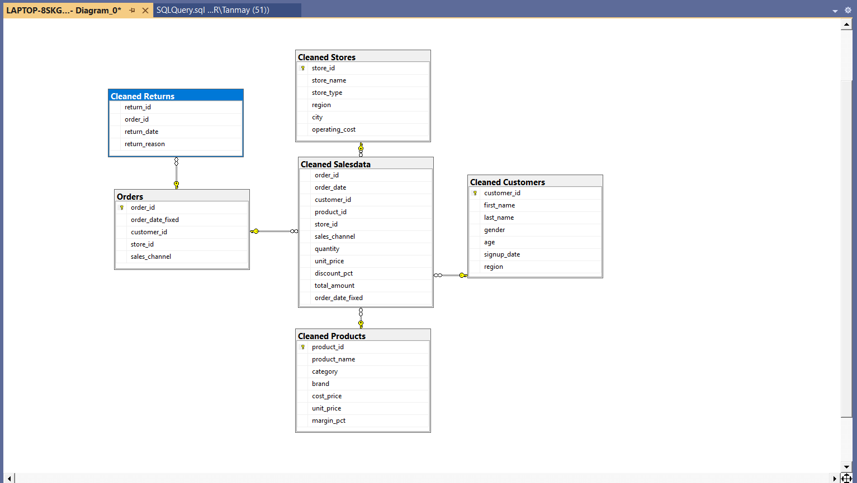
ER Diagram
Structure explanation:
Salesdata acts as the fact table connected to:
Customers Products Stores Orders
Returns table is linked through Order ID.

Slide 8
Power BI Dashboards

Slide 9
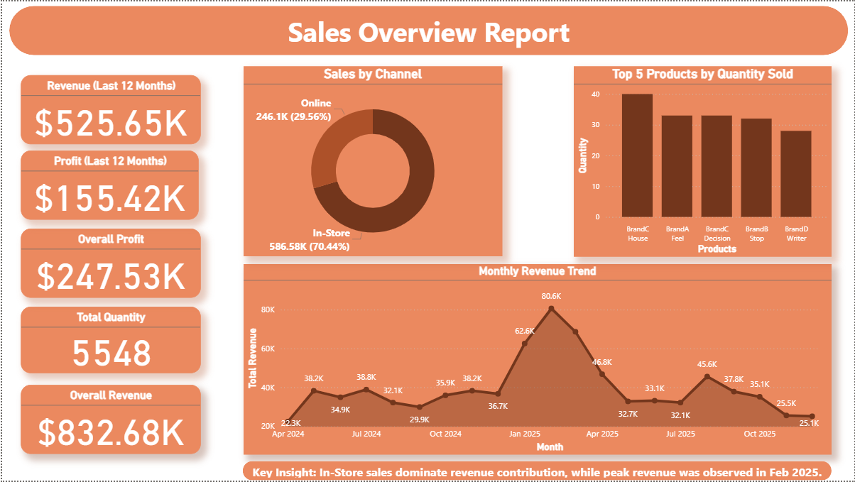
Power BI Dashboards

Slide 10
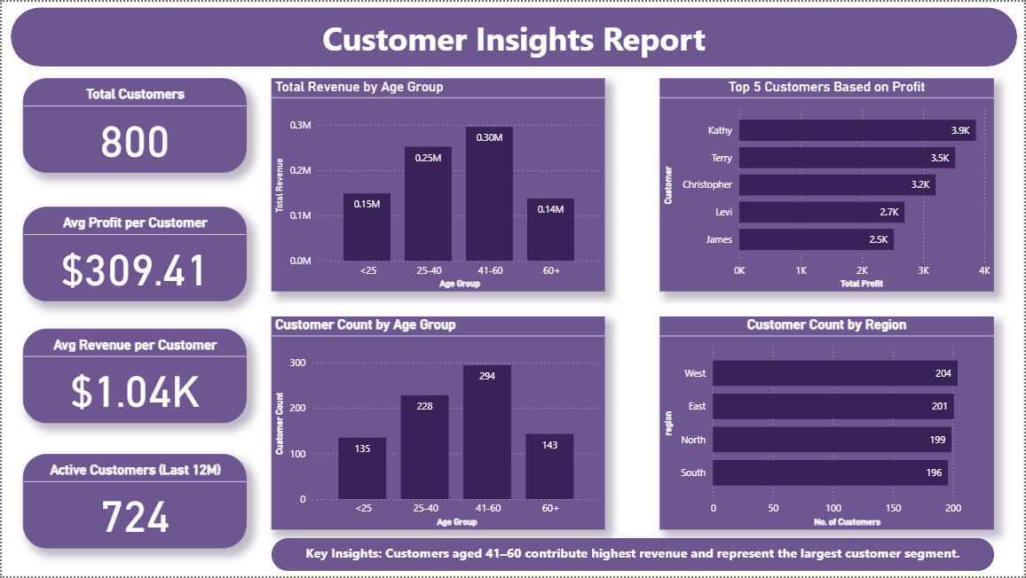
Power BI Dashboards

Slide 11
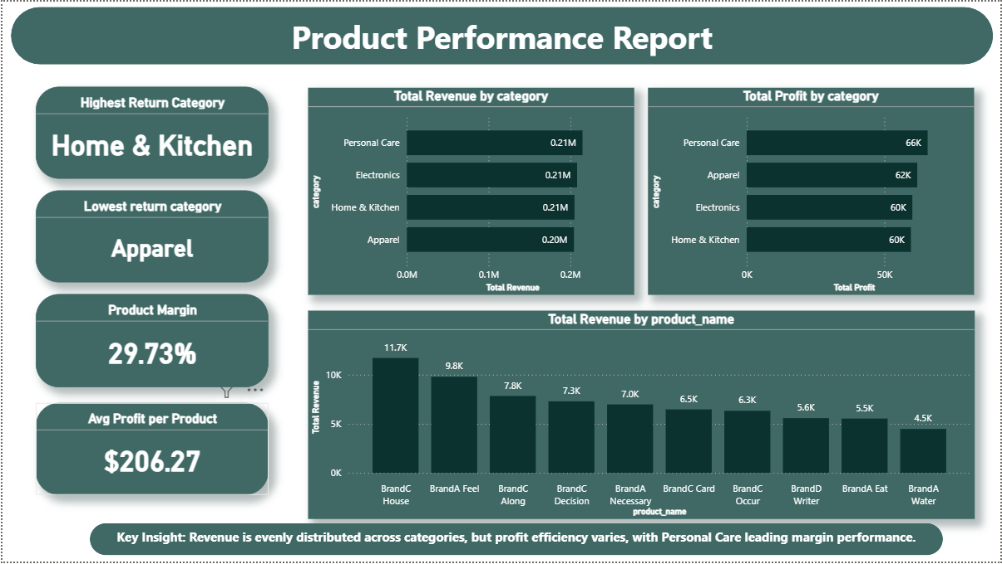
Power BI Dashboards

Slide 12
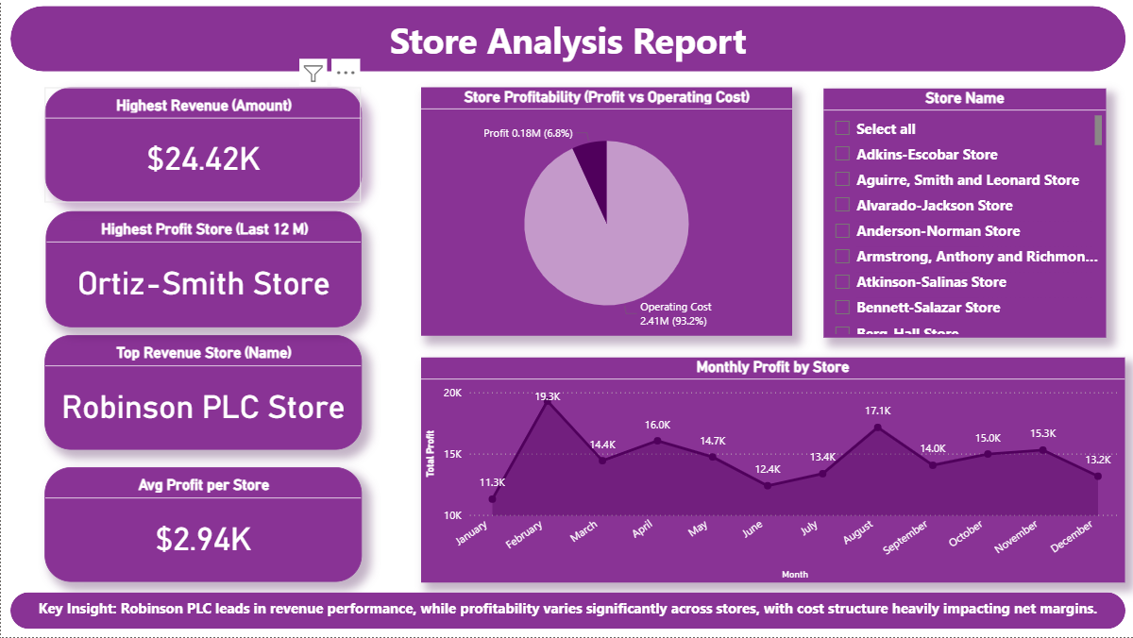
Power BI Dashboards

Slide 13
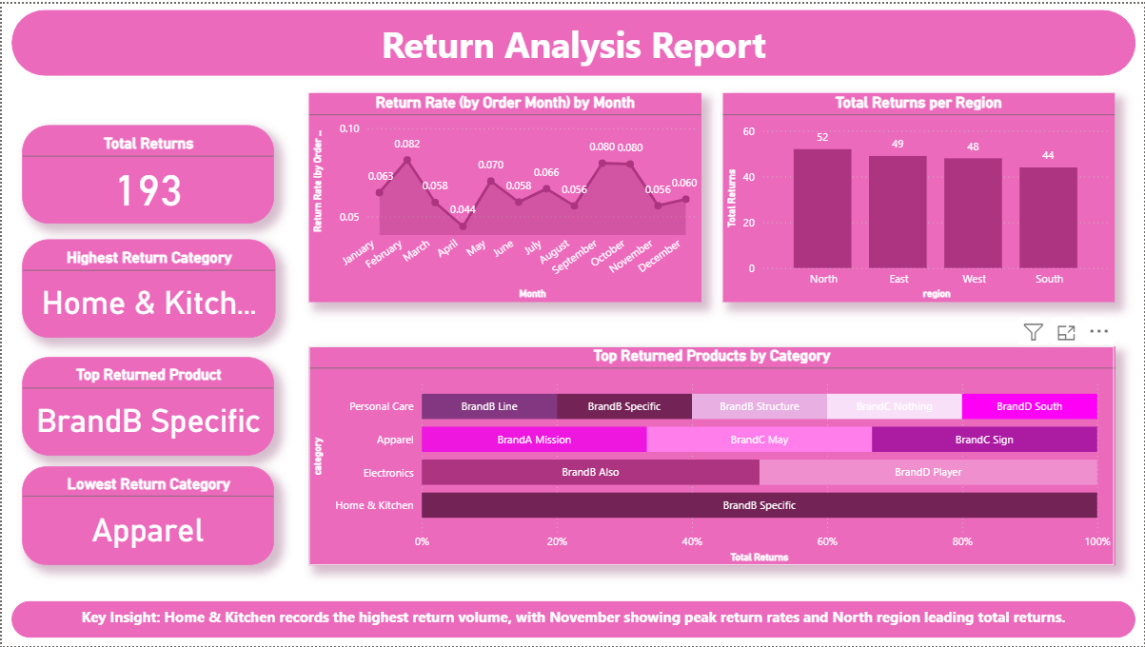

Slide 14
Key Insights
In-Store sales dominate revenue contribution, while peak revenue was observed in Feb 2025.
Customers aged 41-60 contribute highest revenue and represent the largest customer segment.
Revenue is evenly distributed across categories, but profit efficiency varies, with Personal Care leading margin performance.
Robinson PLC leads in revenue performance, while profitability varies significantly across stores, with cost structure heavily impacting net margins
Home & Kitchen records the highest return volume, with November showing peak return rates and North region leading total returns.

Slide 15
Thank You

